Slide 1
The SKYNET 5 Experience
In Operations Development for
Severe Space Weather
SMA 170 – 170308

Slide 2
Training for Live SpaceWx Operations
The Story So Far:
SKYNET has taken part in 3 real-time SpaceWx Exercises, incrementally developing a capability to deal with Severe SpaceWx Effects. 2 further are planned for this year.
The Met Office Space Weather Operations Centre (MOSWOC) acting as our forecaster has been an essential partner throughout – they are an excellent expert partner.
Understanding of the capability for SpaceWx to impact our Spacecraft Operations and Service Delivery and how to mitigate it was actively supported by:
  Our Internal Engineering and Planning teams
  QinetiQ,
  [DSTL],
  and our principal customer, the UK Ministry of Defence.

Slide 3
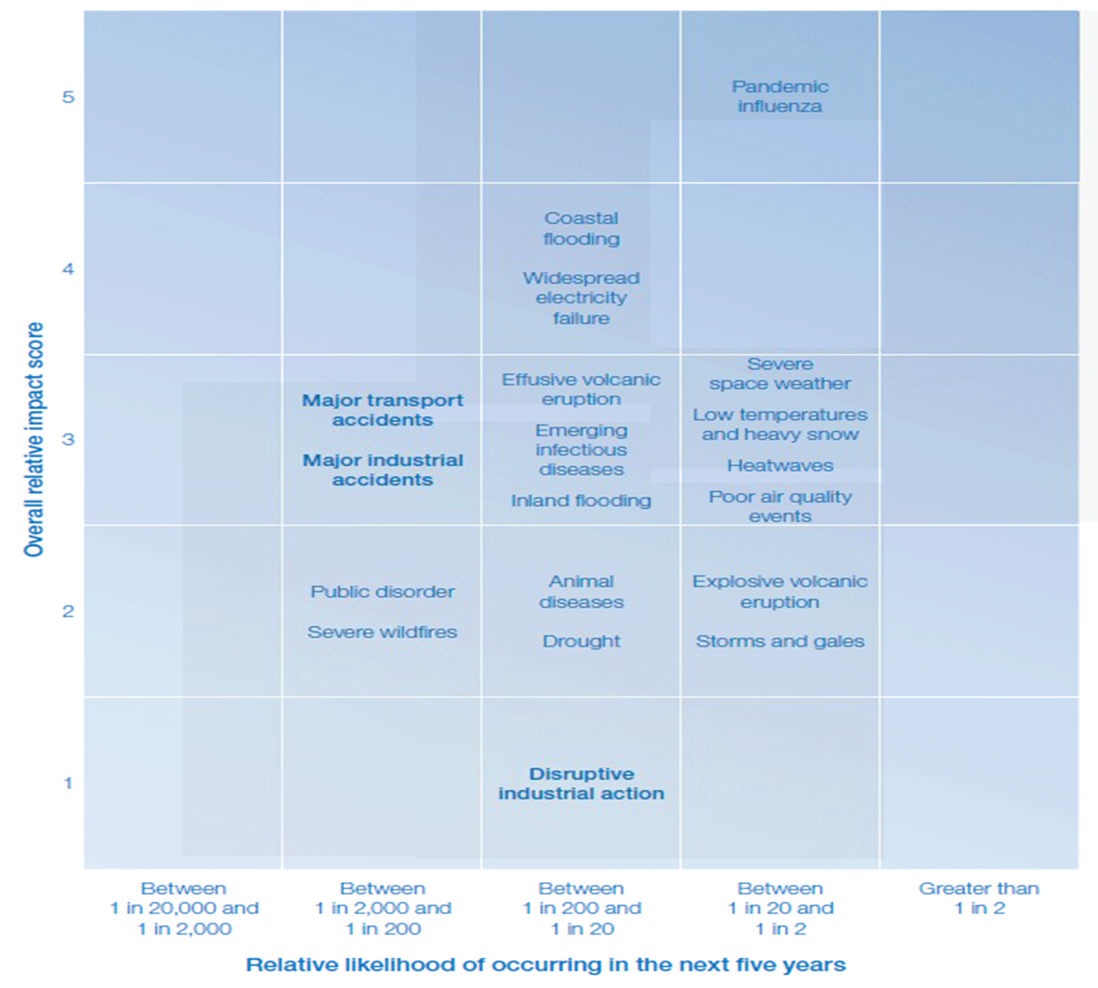
Why Operational Response Capability Development is a ‘Today’ Thing
Government Advice – in the UK, SpaceWx is recognised as a ‘Tier 1 Threat’ in the National Risk Register.
WORSE PROBLEMS

Slide 4
To Develop Operational SpaceWx Mitigation
– a Critical Shopping List
SpaceWx Forecaster Relationship
Engineering and Operational Systems Understanding
Customer Requirements, Expectations and Involvement
Training Development Capability

Slide 5
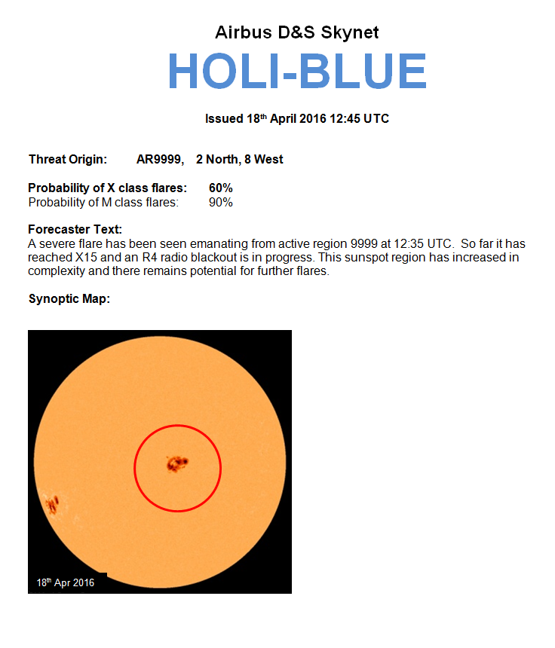
HOLI-STATE Example – Additional to MOSWOC Forecast Generation
  State
  Issue Date
  Threat source summary
  Recent history and Trend
  Highlighted map

Slide 6
MOSWOC HOLI-STATES
  MOSWOC release real-time advice specific to SKYNET when needed in the form of declared Heliographic Observation of Likely Impact (HOLI) States:
  A HOLI-BLUE would precede a HOLI-PURPLE, this being followed by a HOLI-RED:
    HOLI-BLUE when a Solar Feature has potential to cause Severe Space Weather.
    HOLI-PURPLE when a Solar Feature is expected to be a source of Severe Space Weather.
    HOLI-RED when a Solar Feature has produced Severe Space Weather which demands mitigative action.
Though likely that there will be some indication of an increasing SpaceWx risk to Operations from the daily MOSWOC forecasts before a real-time advice HOLI-BLUE is issued, this may not be presumed.

Slide 7
SKYNET Mitigative Actions
Mitigation of the impact of Severe SpaceWx takes three forms:
  Limiting Initiation of Mitigative Action
    Action taken should not initially be Service affecting, but may consume resource in obtaining a better position in both equipment configuration and personnel disposition. The relocation of personnel or placing them on stand-by, deferment of certain Spacecraft Operations, the decision to modify them or bring them forward could all impact some programmed events or lessen the capacity for response with contingencies designed to mitigate other threats.
  Action that Protects Assets
    Such action may be Service affecting, either immediately, due to the reallocation of a resource making a provision, or reduce the capacity for continuation of a provision due to the removal of system or asset diversity to increase the capacity for Severe SpaceWx mitigation.
  Action that Optimises Service Availability and Recovery
    A combination of recognition of the potential effect of Severe SpaceWx on Comms in advance, and as symptoms identified as SpaceWx are experienced, the validation of forecast accuracy will allow coordination of effective recoveries from interruptions.

Slide 8
Customer Requirements, Expectations and Involvement
We have a mechanism for monitoring Service Effectiveness in our Operational Performance with our Principal Customer.
There was a developing mutual recognition that Severe SpaceWx mitigation needed to be addressed. It was quickly recognised that:
SpaceWx Effects could impact their Operations.
Our mitigation of SpaceWx effects could impact upon our Service Provision and Restoration.
This interrelation was complicated and lines of communication, reporting and advice needed development.
Our development of understanding led that of our Principal Customer, who became increasingly supportive in supporting the communications elements of the exercises.

Slide 9
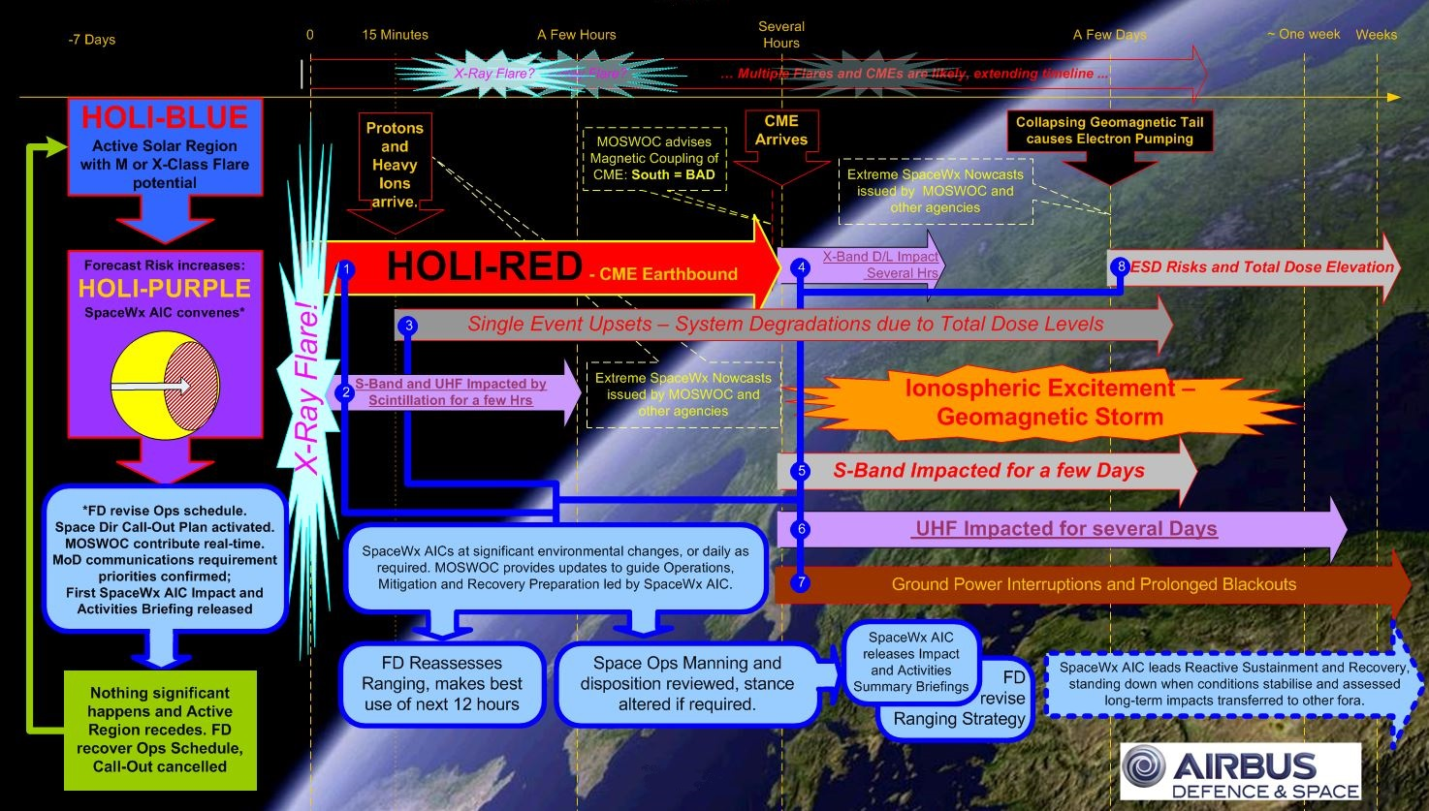

Slide 10
Summary
Mitigative Actions need to happen on establishment of ‘worrying’ conditions NOT on ‘trigger of Index Level Excursion’.
SpaceWx conditions in extreme events is highly variable.
Forecaster interpretation and Revision of the Ongoing Environment Interpretation is absolutely critical for Operations Support.
L5 would allow Forecasters to give Earlier Warnings, and with experience, increased skill in forecasting Event Confidence.

Slide 11
Point of Contact for Questions
Ewan Haggarty
Spacecraft Management Authority
ewan.haggarty@airbus.com
+44 (0) 1249 85 3615
1001 Skynet Drive
CORSHAM
SN13 9NP

